Slide 1

LondonR: Introduction to ggplot2
Nick Howlett
Data Scientist
Email: nhowlett@mango-solutions.com

Slide 2

Agenda
Catie Gamble, M&S - Using R to Understand Revenue Opportunities for your Online Business
Andrie de Vries, RStudio - Tools for using TensorFlow with R
Jeremy Horne, MC&C Media - The power of machine learning in segmenting CRM databases
Chris Hughes, Mango Solutions - RStudio Conference round up

Slide 3
Workshop format
3 Hours
Aimed at beginner level
Worked examples
Exercises

Slide 4
Workshop Agenda
What is ggplot2?
Why use ggplot2?
Introduction to qplot()
Introduction to layering
Introduction to ggplot() and aes()
Advanced examples – including theming

Slide 5
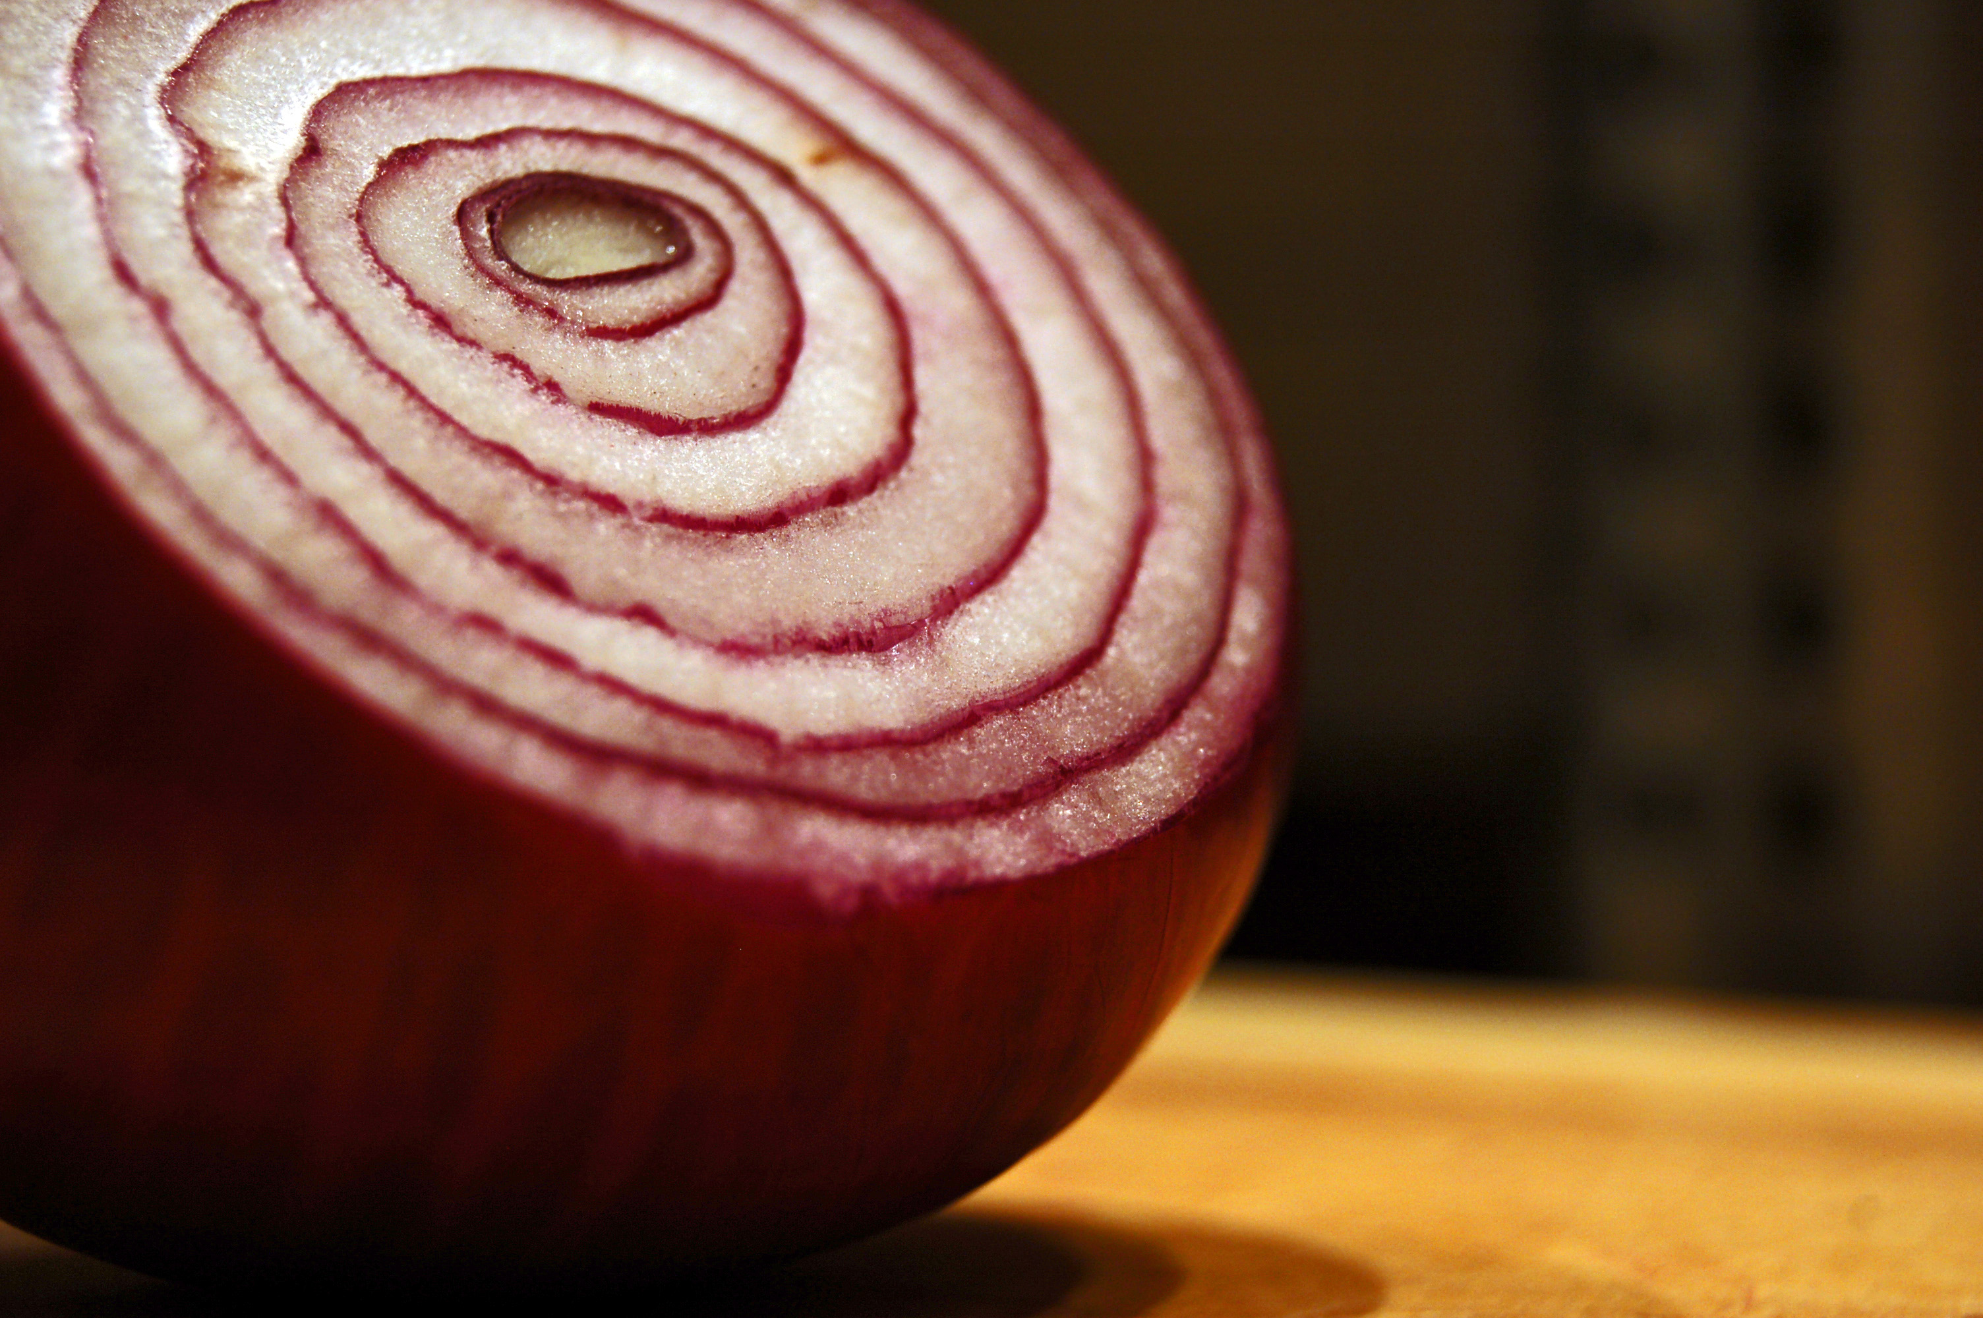
What is ggplot2?
ggplot2 is a graphical package created by Hadley Wickham
Implementation of the ideas from “The Grammar of Graphics”
Plots are stored in objects
Plots are built up by layering

Slide 6
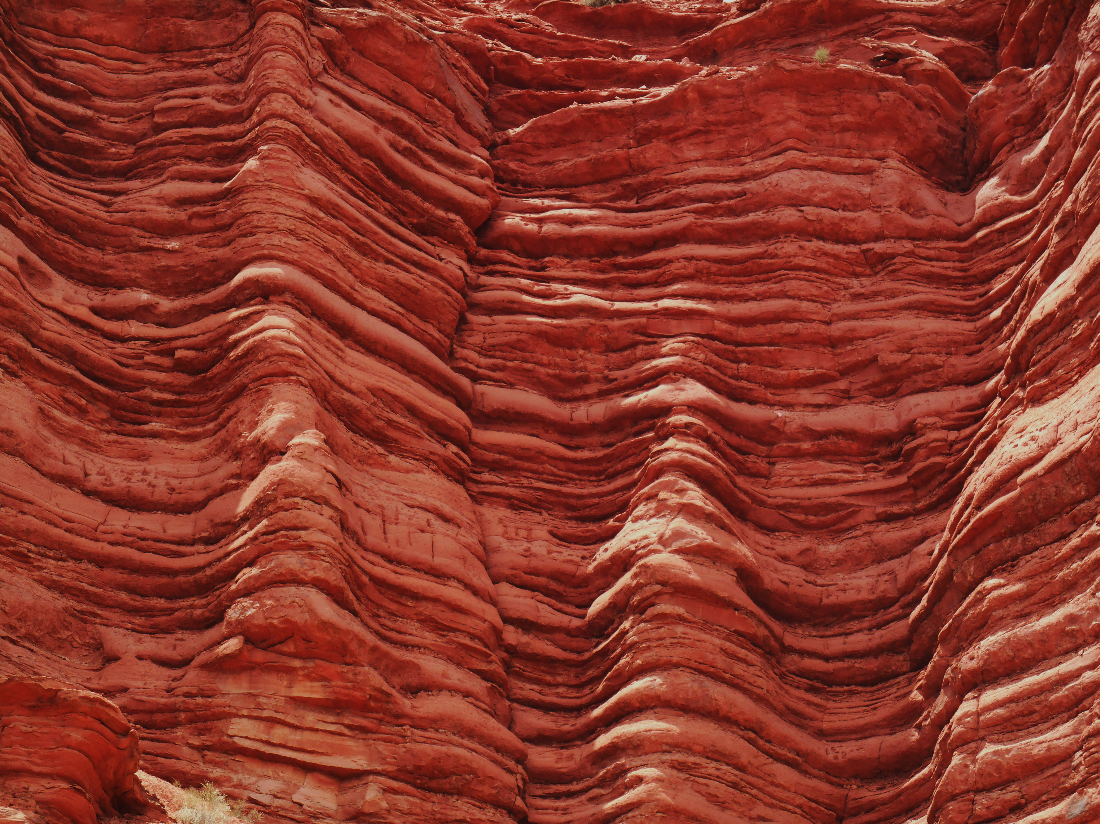
What is “The Grammar of Graphics”?
Book by Leland Wilkinson
An alternative way of describing ‘data graphics’
A formal system for generating graphics
Language for building graphics
Common principals across charts
Linkage between the data and the properties of the graphic

Slide 7

What is “The Grammar of Graphics”?
All charts have these four ‘layers’ in common
Coordinates
Geometries
Aesthetics
Data

Slide 8
Spot the difference:

Slide 9
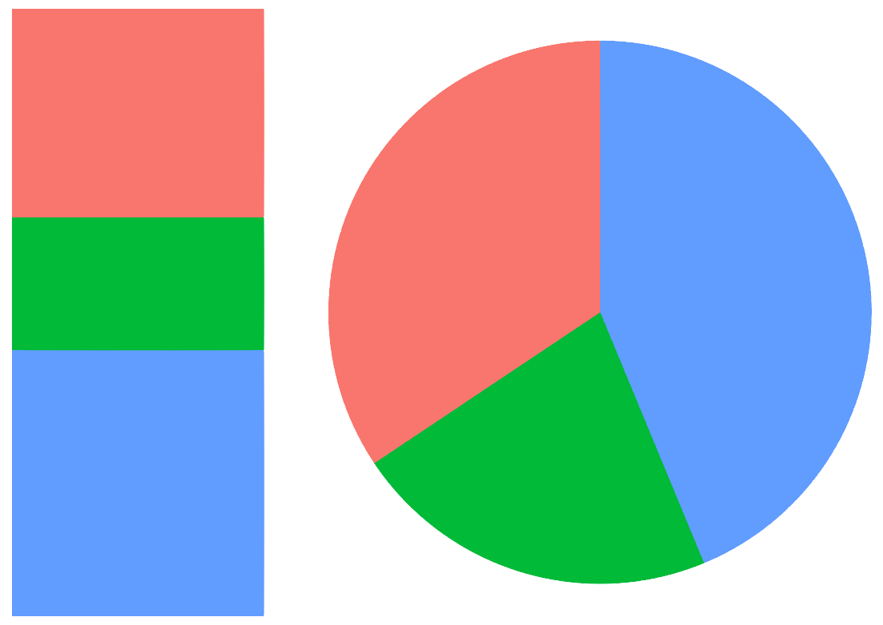
Spot the difference:

Slide 10

Why ggplot2
Benefits of ggplot2 are similar to the benefits of Object Oriented Programming:
General approach is at a lower level
User is forced to think more fundamentally about the plot
Flexibility in displaying data graphically
Scales very well with complex plots

Slide 11
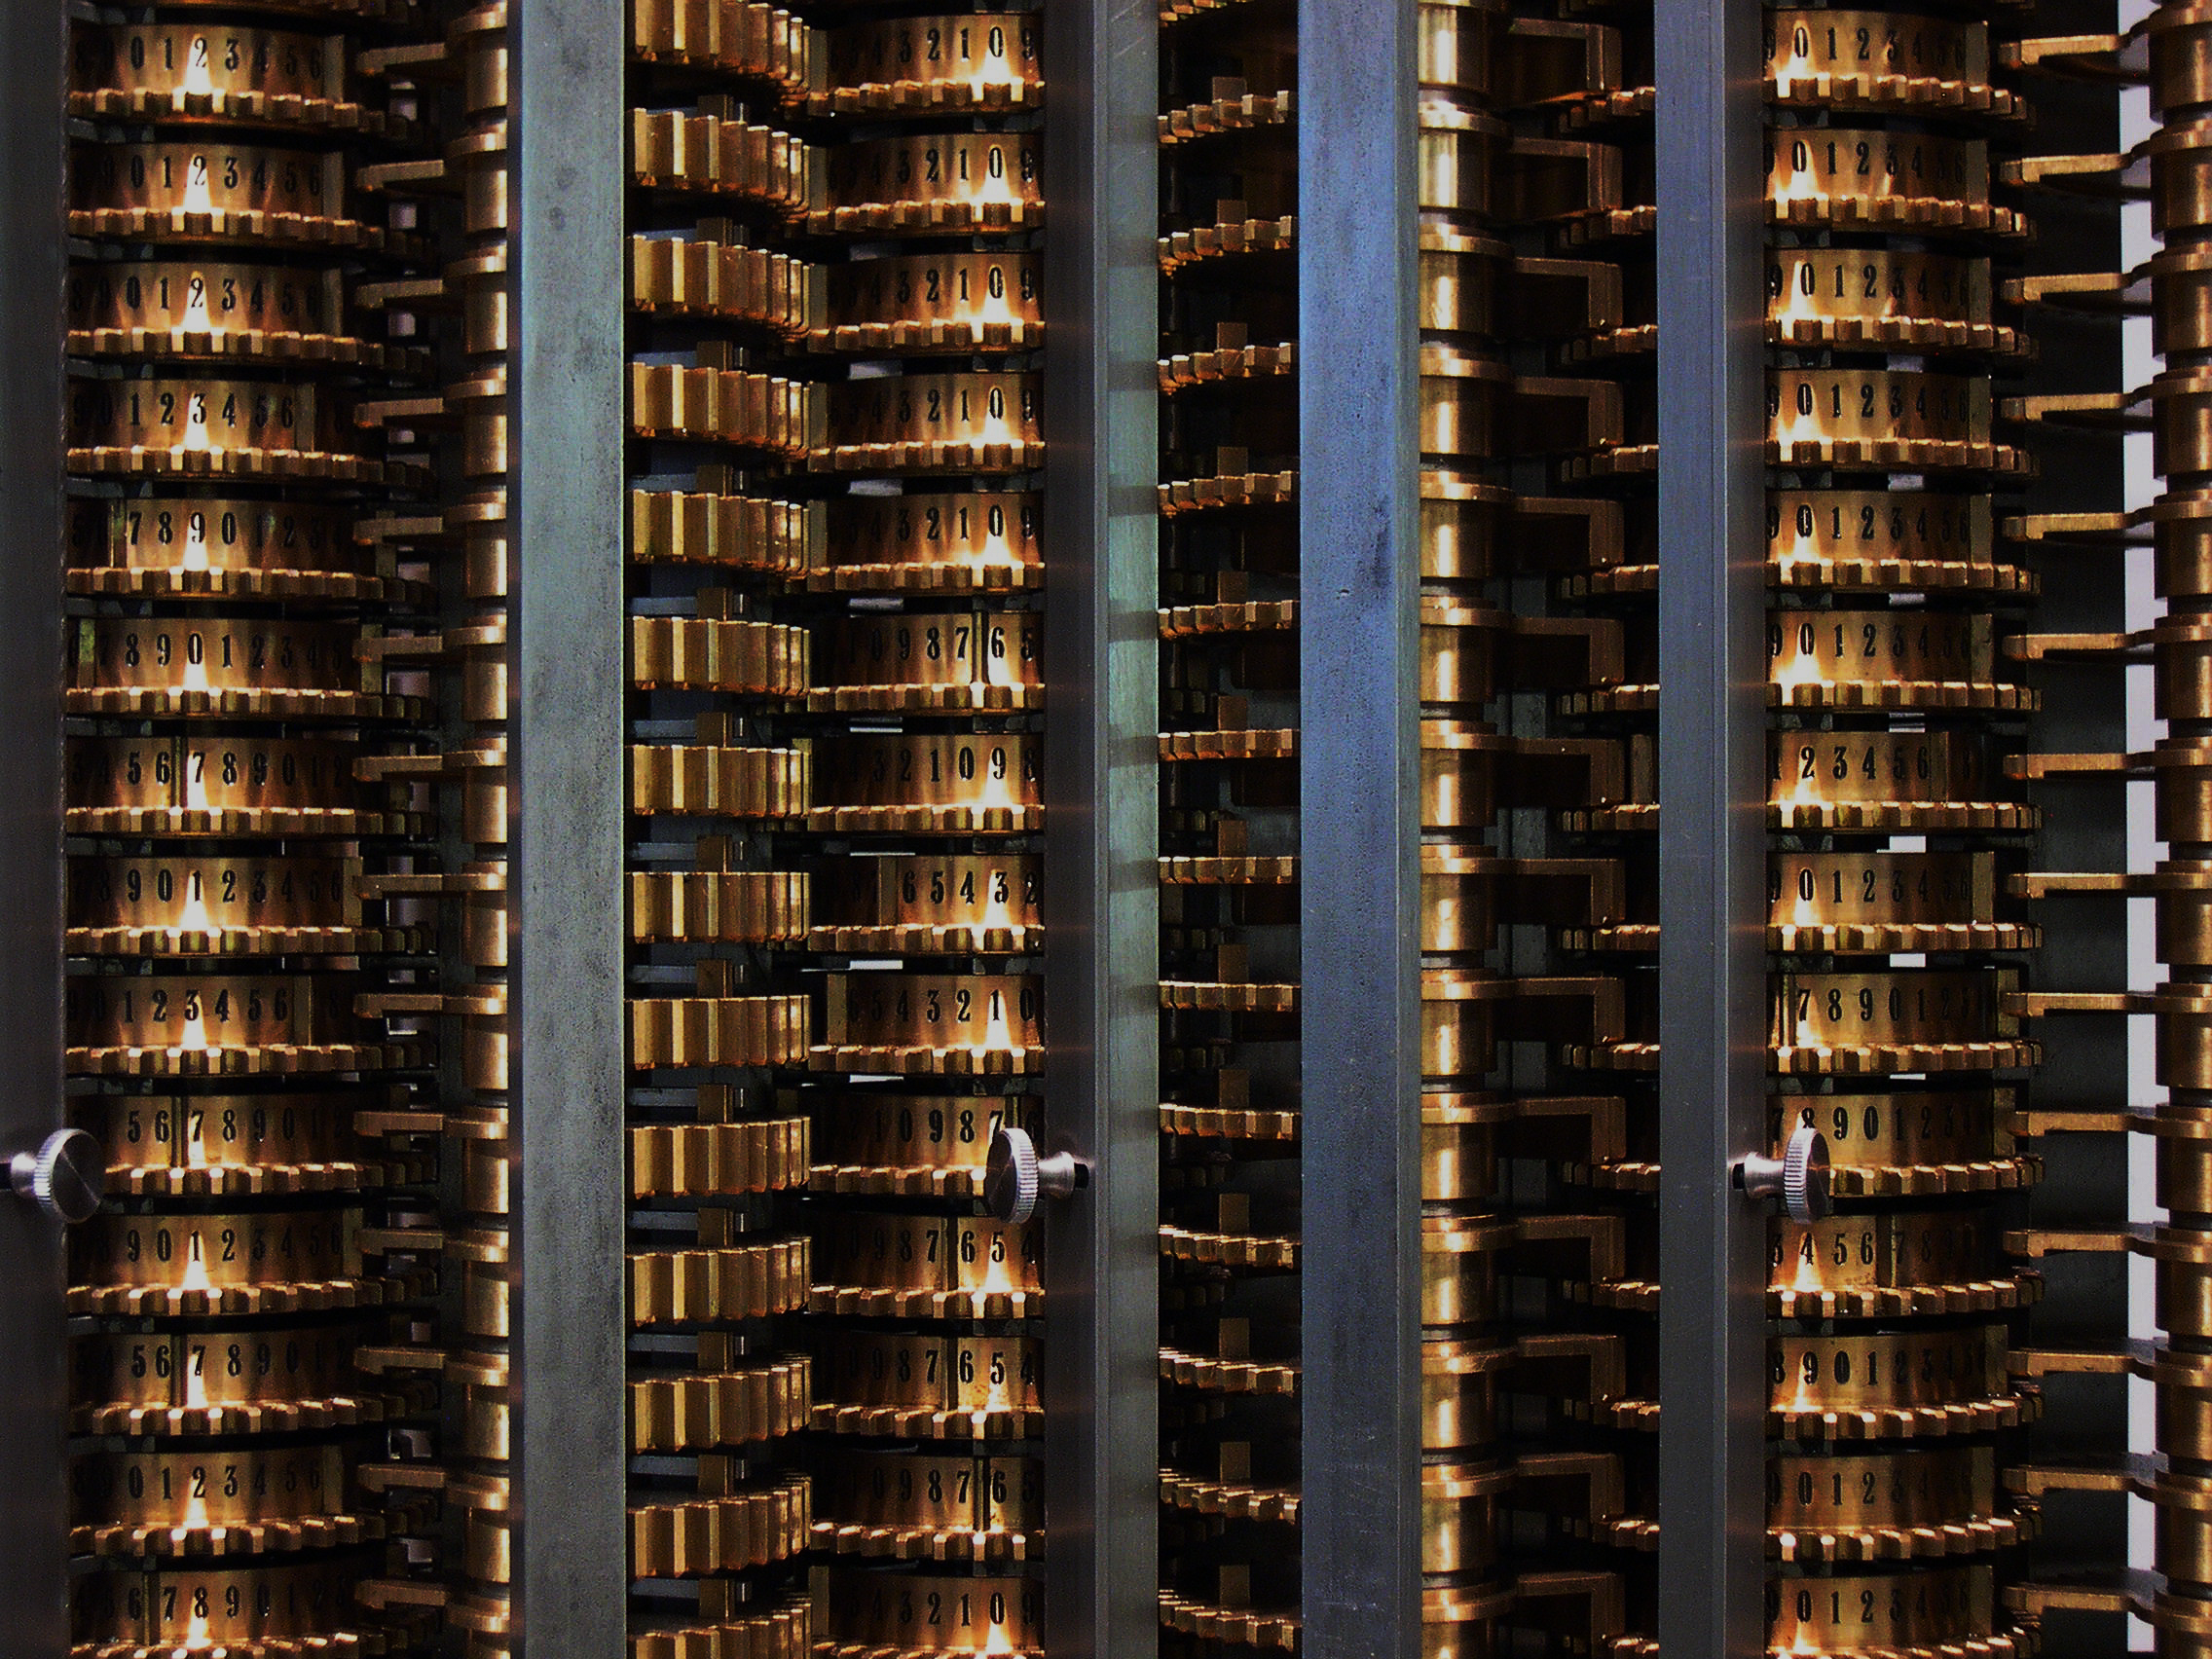

Code Examples

Slide 12
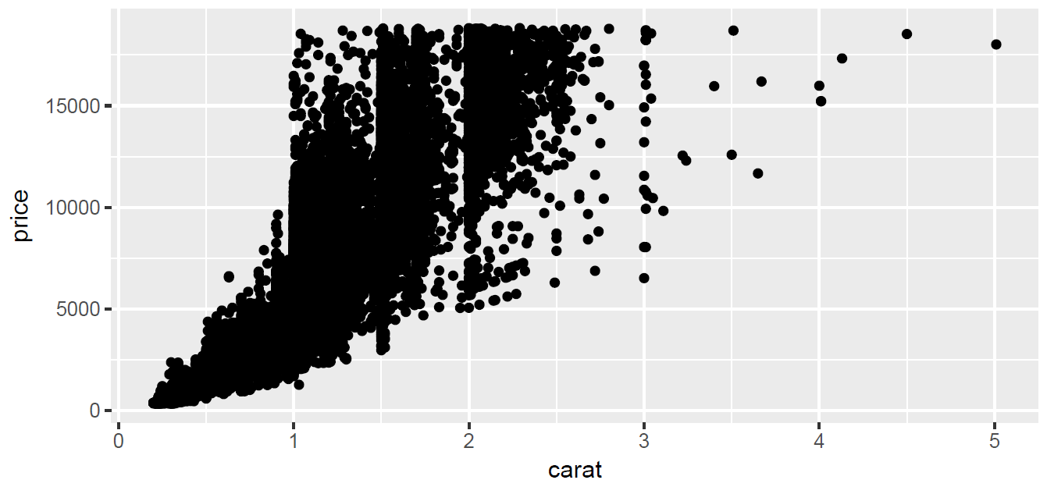
The qplot() function
Designed for quick, exploratory plotting – makes assumptions about the plot – given two continuous variables qplot() produces a scatter plot
myPlot <- qplot(carat, price, data = diamonds)
myPlot

Slide 13
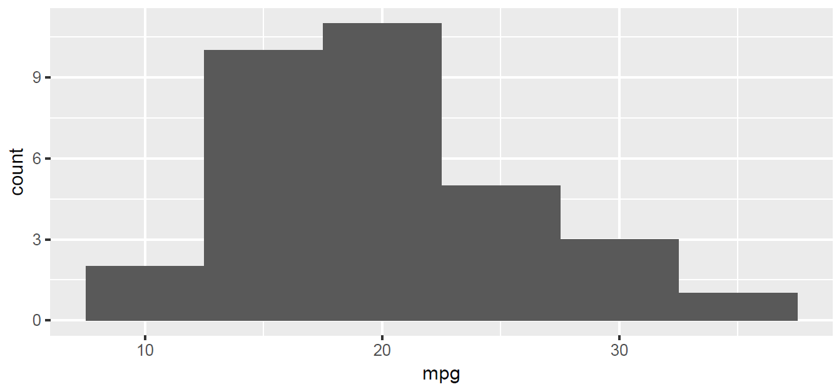
The qplot() function
Given one continuous variables qplot proudces a histogram – qplot() can take many plot-specific arguments
qplot(x = mpg, data = mtcars, binwidth = 5)

Slide 14
Titles and Axis Labels
With qplot() labelling is similar to the base graphics package
We can add a main title to our plot using the main argument
Arguments xlab and ylab control the axis labels for the x and y axes respectively

Slide 15
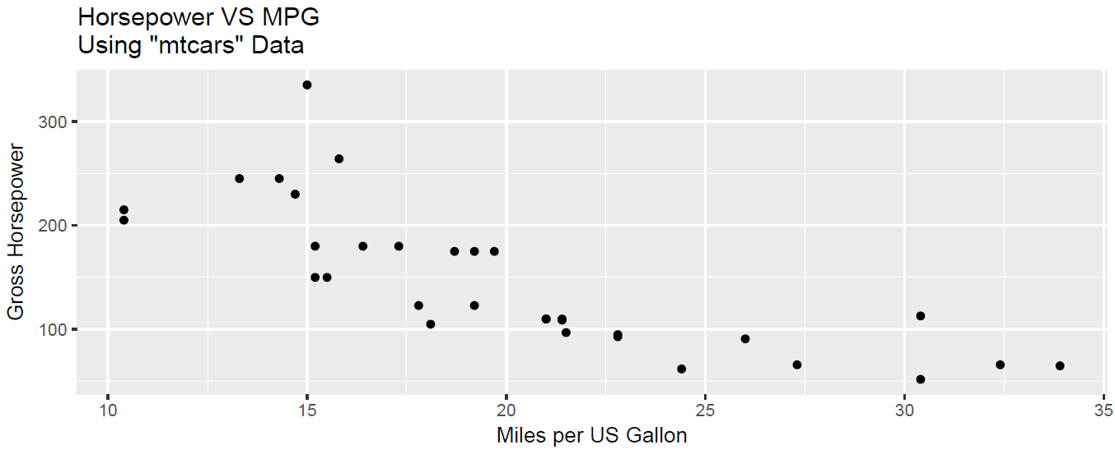
Titles and Axis Labels
qplot(hp, mpg, data = mtcars,
main = 'Horsepower vs MPG\nUsing \"mtcars\" Data',
xlab = 'Miles/US Gallon',
ylab = 'Gross Horsepower')

Slide 16
Axis Limits
The xlim and ylim arguments to the plot functions allow users to control the X and Y axis limits
These arguments must be provided with a vector of length 2

Slide 17
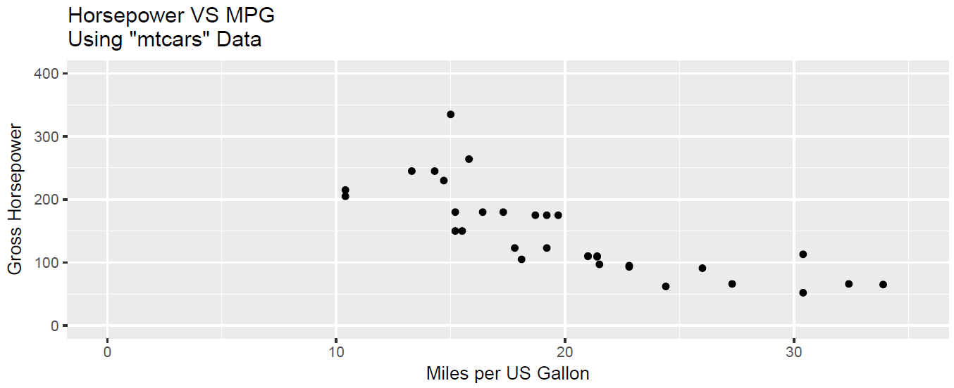
Axis Limits
xRange <- c(0, 35) # A 2-element numeric vector
yRange <- c(0, 400)
qplot(mpg, hp, data = mtcars,
main = 'Horsepower Vs MPG\nUsing \"mtcars\" Data\n',
xlab = 'Miles/US Gallon',
ylab = 'Gross Horsepower',
xlim = xRange, ylim = yRange)

Slide 18
Exercise
Create a plot of Conc against Time from pkData (in the mangoTraining package). Ensure that the plot has appropriate titles and axis labels
Ensure that the Conc axis ranges from 0 to 2500
Create a histogram of Weight from demoData
Write the above plots to a single pdf file

Slide 19
Layering
In the previous examples options were added as function arguments, eg
Using the ggplot2 philosophy we can also add these options as “layers”
Layers are ‘added’ using the + symbol
xlim = xRange

Slide 20
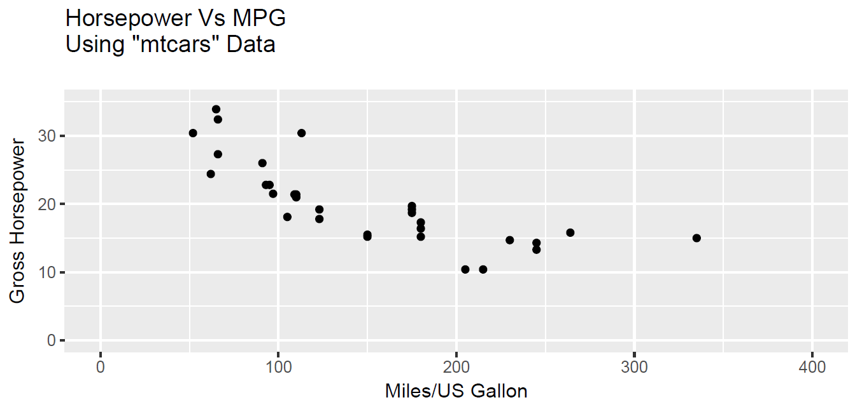
Layering
qplot(hp, mpg, data = mtcars) +
ggtitle('Horsepower Vs MPG\nUsing \"mtcars\" Data\n') +
xlab('Miles/US Gallon') +
ylab('Gross Horsepower') +
xlim(xRange) +
ylim(yRange)
Later we will see how layers add to the flexibility to ggplot2
Notes:
The same plot above could be created using the following code with functions ggtitle, xlab and ylab, xlim and ylim used to add the main title, axis labels and set the axis limits respectively.

Slide 21
Plot Types - aka The “Geoms”
The concept of “geoms” negates the need for multiple graphic functions
Eg histogram() or bwplot() that are used in lattice to draw histograms and boxplots respectively
Within qplot we simply add an argument geom which defines how the data are to be displayed
Notes:
Factor converts from continuous to categorical.

Slide 22
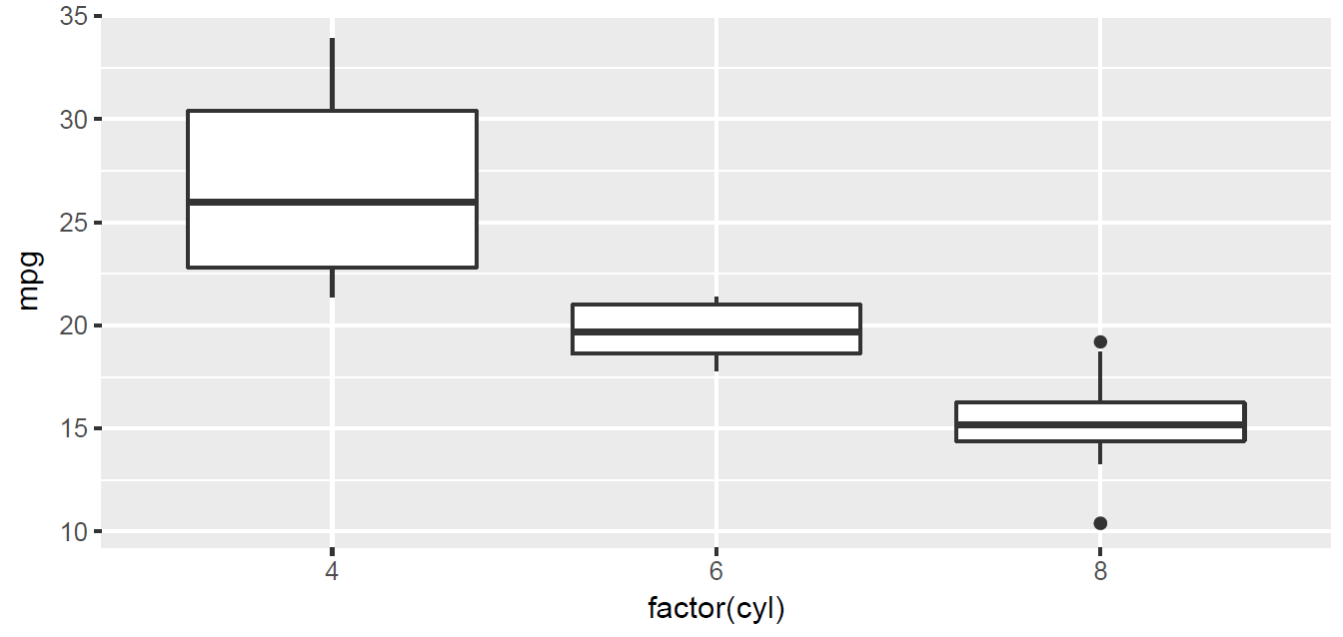
Plot Types - aka The “Geoms”
qplot(factor(cyl), mpg, data = mtcars, geom = "boxplot")
Note: the use of factor in the previous example. It is important to consider the type (class) of data when using ggplot2.
Notes:
Factor converts from continuous to categorical.

Slide 23
Adding New ‘geom’ Layers
When we specify geom argument within the qplot function, we are in fact calling out to one of many geom functions that tell R how to display the graphic.
All geometric functions in ggplot2 have a geom_ prefix
The code below finds all of the geom functions within the ggplot2 package
grep("^geom", objects("package:ggplot2"), value = TRUE)
[1] "geom_abline" "geom_area" "geom_bar" "geom_bin2d"
[5] "geom_blank" "geom_boxplot" "geom_col" "geom_contour"
[9] "geom_count" "geom_crossbar" "geom_curve" "geom_density"
[13] "geom_density_2d" "geom_density2d" "geom_dotplot" "geom_errorbar"
[17] "geom_errorbarh" "geom_freqpoly" "geom_hex" "geom_histogram"
[21] "geom_hline" "geom_jitter" "geom_label" "geom_line"
[25] "geom_linerange" "geom_map" "geom_path" "geom_point"
[29] "geom_pointrange" "geom_polygon" "geom_qq" "geom_quantile"
[33] "geom_raster" "geom_rect" "geom_ribbon" "geom_rug"
[37] "geom_segment" "geom_smooth" "geom_spoke" "geom_step"
[41] "geom_text" "geom_tile" "geom_violin" "geom_vline"

Slide 24
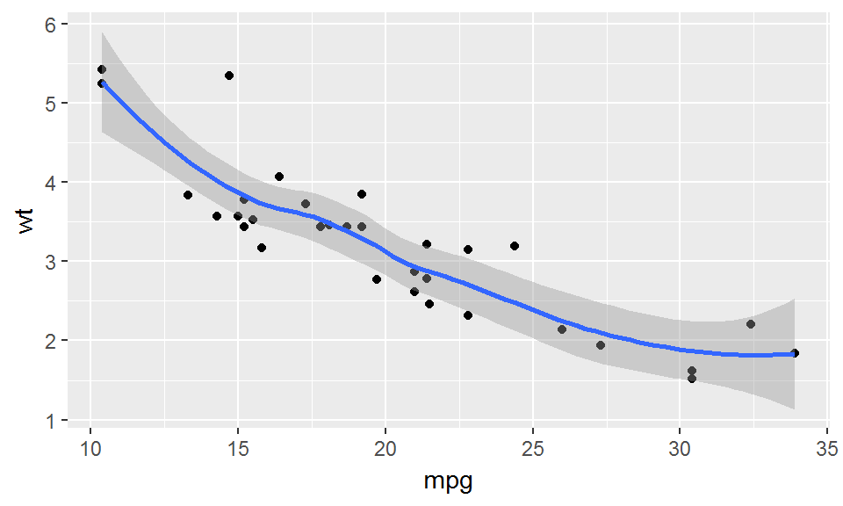
Adding New “geom” Layers
We can call any of these geom functions directly in order to add layers to our plot
We do this using the + operator.
qplot(mpg, wt, data = mtcars) + geom_smooth(method = "loess")
# See ?geom_smooth for details on method

Slide 25
Exercises
Create a boxplot of Height by (against) Sex from demoData
Generate some random numbers using rnorm() and draw a simple density plot to display the data
Create a plot of Conc against Time from pkData
Add a smoothing line to the plot
Extension Question:
5. Change the smoothing function in the previous exercise to a linear (“lm”) smoother (not statistically sensible) and remove the error bars.

Slide 26
Aesthetics and Groups
Perhaps the primary advantage of using ggplot2 over the standard R graphics, or lattice, is the ease of which aesthetics can be used in order to highlight features of our data
However, for the ggplot2 newcomer, it is also one of the trickiest areas to get right!
Note: The term “aesthetics” has a specific meaning in ggplot2 (later). Here we refer to colour, shape, size, etc.
The ggplot2 package allows for both the traditional aesthetics names (e.g. col, pch, cex) and a more user-friendly naming (e.g. colour, shape, size)

Slide 27
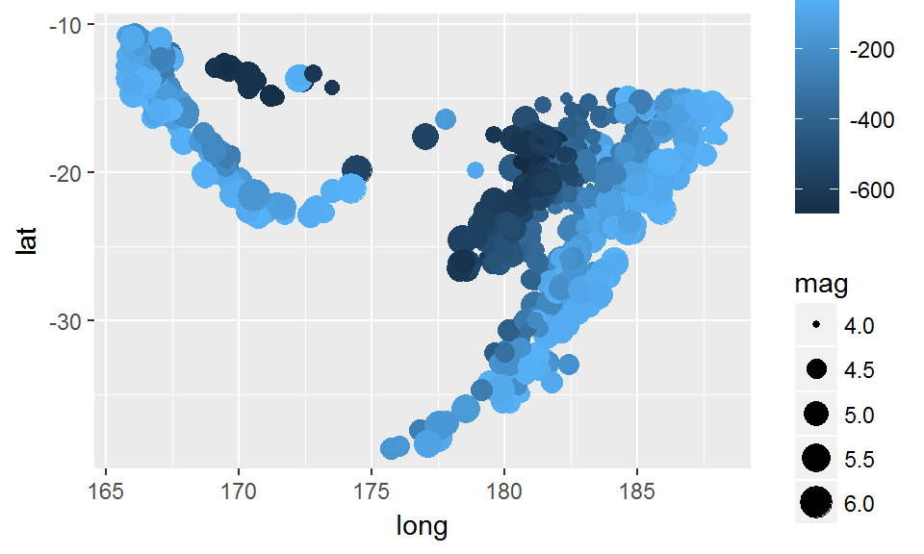
Aesthetics
Unlike the standard R graphics and lattice, we do not specify aesthetic attributes via vectors
Instead we refer to a variable in the data and let ggplot do the hard work
qplot(long, lat, data = quakes, size = mag, col = -depth)

Slide 28
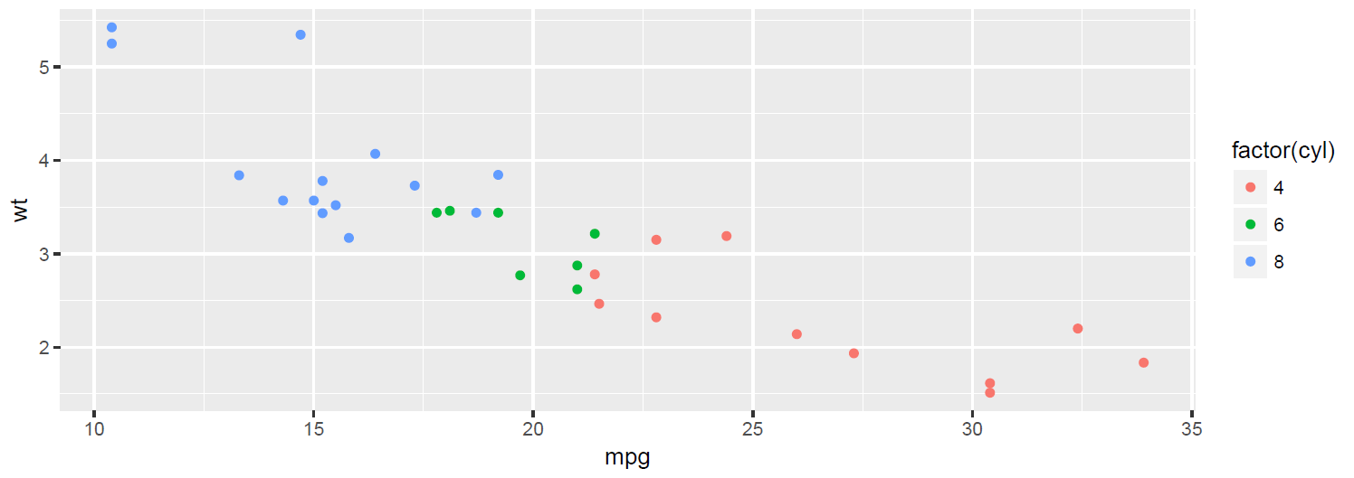
Factors
The class of a variable is very important when using ggplot2
If we have numeric data representing different categories, it is important that we convert these variables to factors
If we do not, then a natural ordering is implied by the default aesthetics
Warning: Attempting to vary the plotting shape by a numeric variable will cause an error!
qplot(mpg, wt, data = mtcars, colour = factor(cyl))

Slide 29
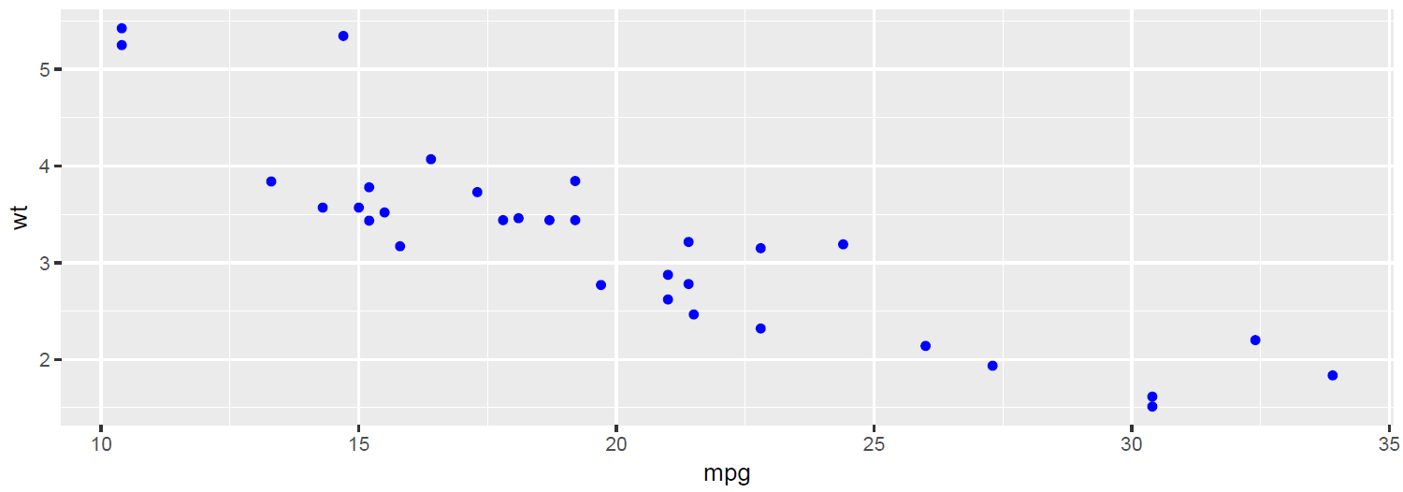
Traditional Specification of Aesthetics
ggplot2 has been designed to allow variables to be used with aesthetics
We therefore have to use a special function I() in order to allow for a more traditional specification of aesthetics
qplot(mpg, wt, data = mtcars, colour = I("blue"))

Slide 30
Exercises
Create a scatter plot of Height against Weight using demoData. Use a different colour to distinguish between males and females and a different plotting symbol dependent upon whether the subject smokes or not.
Increase the size of the points on the previous plot to twice the default size.

Slide 31
Advanced Control of Aesthetics
We can add “scaling” layers to a plot in order to control how aesthetics such as colour are used in the plot
The scale functions begin with the prefix scale_
Note: ggplot2 allows for both UK and US spellings of ‘colo[u]r’
grep("^scale", objects("package:ggplot2"), value = TRUE)
[1] "scale_alpha" "scale_alpha_continuous"
[3] "scale_alpha_discrete" "scale_alpha_identity"
[5] "scale_alpha_manual" "scale_color_brewer"
[7] "scale_color_continuous" "scale_color_discrete"
[9] "scale_color_distiller" "scale_color_gradient"
[11] "scale_color_gradient2" "scale_color_gradientn"
[13] "scale_color_grey" "scale_color_hue"
[15] "scale_color_identity" "scale_color_manual"
[17] "scale_colour_brewer" "scale_colour_continuous"

Slide 32
Advanced Control of Aesthetics
The scale_ function chosen must match the data type
For example, if we vary colour by a continuous variable then we will need a colour scale function that works with continuous data, for example scale_ colour_continuous
In addition to the more obvious ‘discrete’ and ‘continuous’ scales, there are a number of other useful aesthetic scales available in ggplot2
For example, scale_ colour_gradientn creates a continuous colour through ‘n’ colours
The manual suffix allows us to be specific about the aesthetics we use for discrete variables

Slide 33
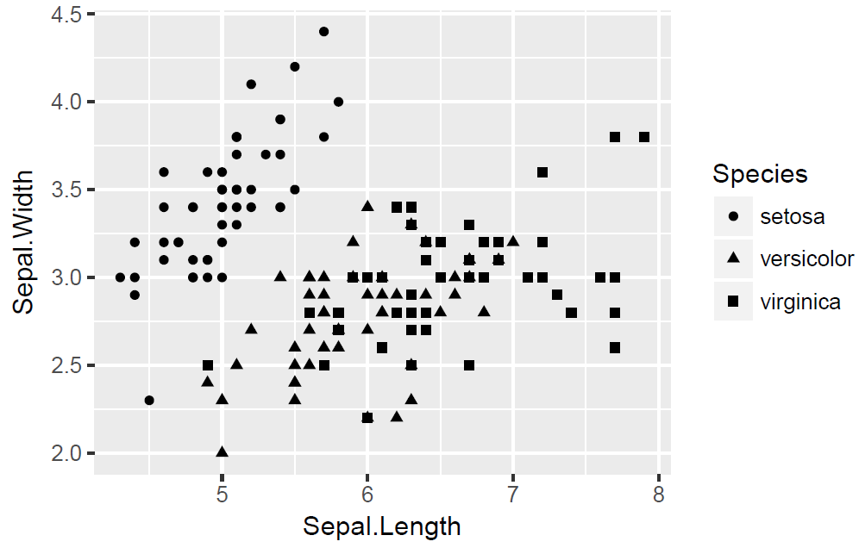
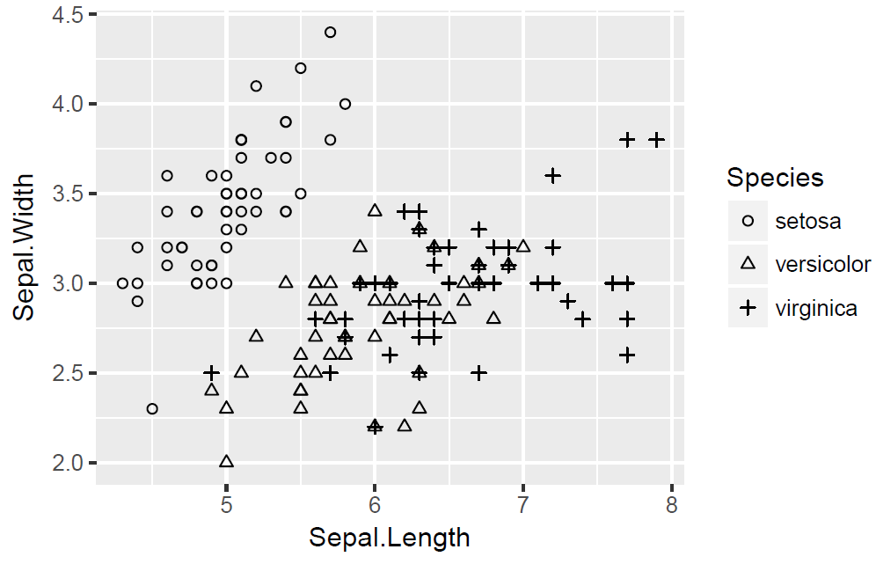
Advanced Control of Aesthetics
irisPlot <- qplot(Sepal.Length, Sepal.Width,
data = iris, shape = Species)
irisPlot
irisPlot + scale_shape_manual(values = 1:3)

Slide 34
Legend Control
Another advantage of ggplot2 is the auto-generation of the legend
However this is another area that can be confusing to the ggplot2 newcomer
The legend is generated when an aesthetic is used
The same scale_ functions that allow us to control the aesthetics, also allow us control of the legend
The first argument to the aesthetic scale functions controls the title that appears in the legend

Slide 35
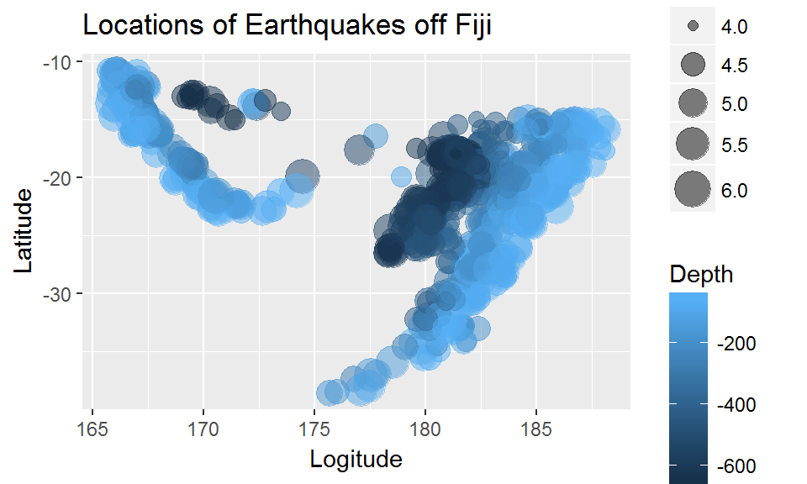
Legend Control
fiji <- qplot(long, lat, data = quakes,
size = mag, col = -depth,
alpha = I(0.5),
xlab = "Logitude", ylab = "Latitude",
main = "Locations of Earthquakes off Fiji")
fiji + scale_colour_continuous("Depth") +
scale_size_continuous("Magnitude", range = c(2,8))

Slide 36
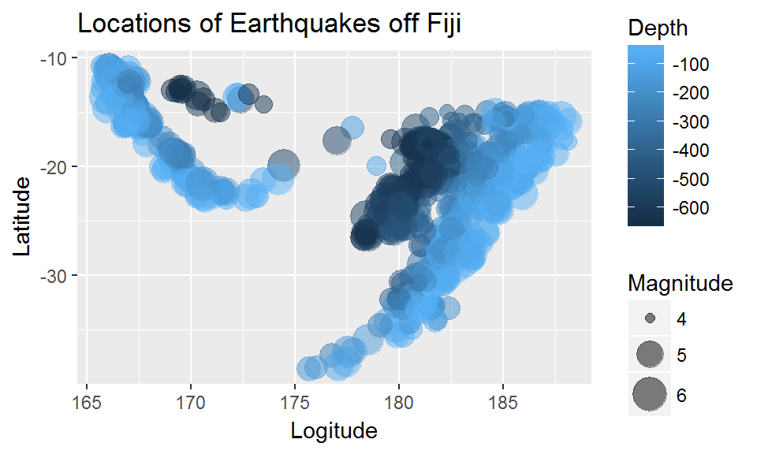
Legend Control
fiji + scale_colour_continuous("Depth",
breaks = seq(0, -600, -100)) +
scale_size_continuous("Magnitude", range = c(2,8), breaks = 4:6)
We can also control how continuous variables are displayed within the legend

Slide 37
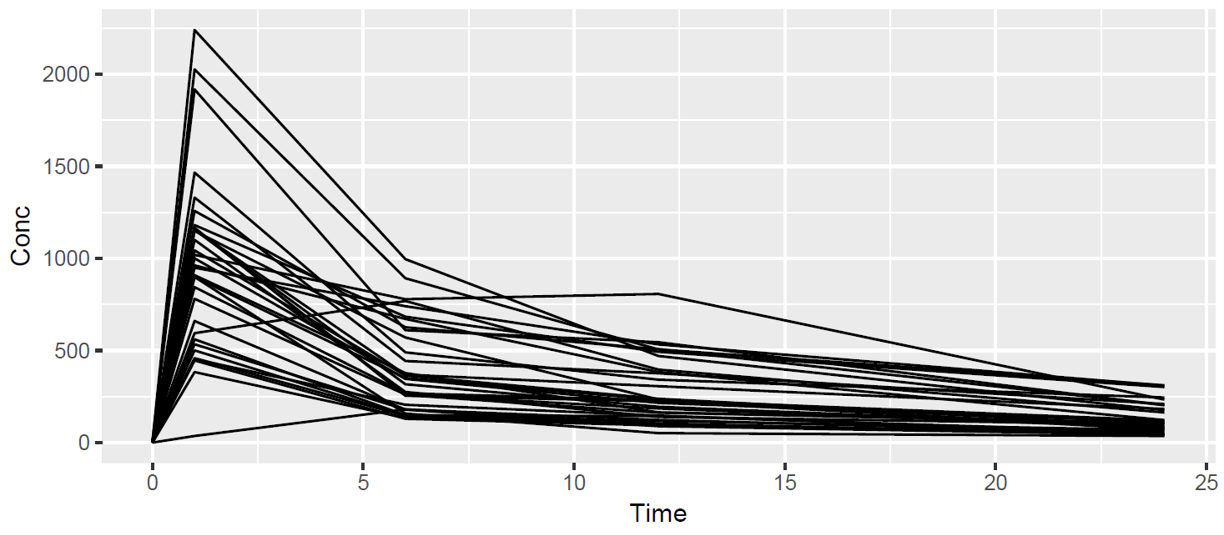
Grouping
For certain types of plot, for example ‘line’ plots, we can also specify an inherent grouping
Grouping can be used when we wish to separate out the levels of a factor but have no interest in comparing between these levels (e.g. using colour)
qplot(Time, Conc, data = pkData, geom = "line", group = Subject)

Slide 38
Panelling, aka “Faceting”
ggplot2 provides a simple mechanism for panelling by a variable(s)
In ggplot2, panelling is known as “faceting”
We can either add a facets argument to qplot or add a separate layer using either facet_grid or facet_wrap
The facet_grid function stacks the panels vertically or horizontally by the levels of a factor
facet_wrap fills the available area much like lattice
Faceting requires a formula of the form [rows] ~ [cols], where “rows” and “cols” can be replaced by either a variable name
A “.” can be used if panelling of one of rows or columns is not required

Slide 39
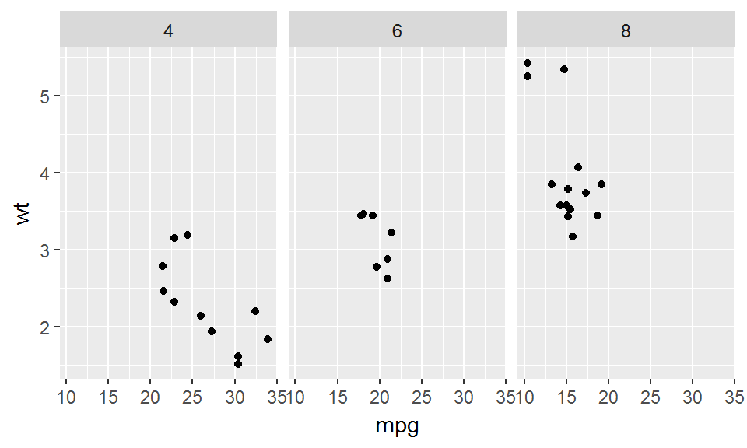
Panelling, aka “Faceting”
qplot(mpg, wt, data = mtcars) + facet_grid(.~cyl)
Note: If using the facets argument to qplot, we can omit the “.” to invoke facet_wrap

Slide 40
Exercises
Draw a “line” plot of Conc against Time from pkData and colour by Dose.
Change the previous plot so that each level of Dose is instead represented by a separate panel
Draw a “line” plot of Conc against Time from pkData. Ensure each Subject is drawn in a different panel and vary the line type by Dose
Create a plot of Height against Weight from demoData. Panel (facet) the plot to show levels of Sex in the rows and Smokes in the columns.

Slide 41
Advanced Control - the ggplot() function
In the examples thus far we have first created a basic ggplot2 object using qplot() and added to this using a variety of layers
The ggplot() function makes no assumptions about the plot type or even the coordinate system
It simply creates an empty ggplot2 graphical option onto which we can add layers of information
This can be very useful when highly customised graphics are required
Warning Calling ggplot() without any additional layers will produce an error!

Slide 42
Advanced Control - the aes() function
aes() function is used to map “aesthetics”
In ggplot2 terminology, this refers not only to colour, shape or size, but to the x and y variables and a number of other graphical attributes
For the ggplot2 newcomer, the aes() function is perhaps one of the most confusing aspects of the package!
However the function is actually very straightforward to use

Slide 43
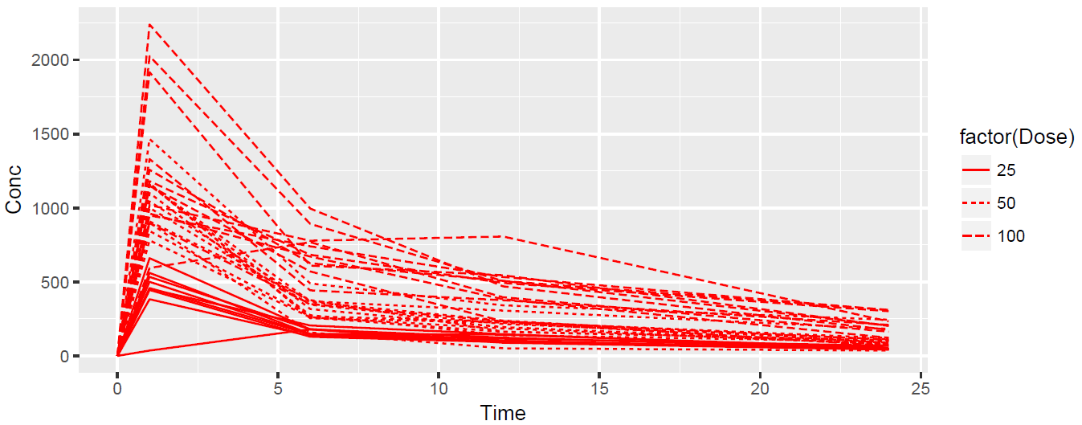
The aes() function
If we wish to refer to any variable in the dataset via a function argument, whether this is to assign it to the x axis, or colour by the variable, we must ‘wrap’ the argument in a call to aes()
The dataset itself does not need to be contained within the call to aes()
concPlot <- ggplot(data = pkData, aes(x = Time, y = Conc,
group = Subject,
linetype = factor(Dose)))
concPlot <- concPlot + geom_line(colour = "red")
concPlot

Slide 44
The aes() function
aes() is given to the mapping argument of either ggplot() function OR individual geom_ functions.
concPlot <- ggplot(data = pkData)
concPlot + geom_line(aes(x = Time, y = Conc,
group = Subject,
linetype = factor(Dose)),
colour = "red")

Slide 45
A recipe for ggplot charts
Given the inputs:
<DATA>
<GEOM_FUNCTION>
<MAPPING>
<FACET_FUNCTION>
We can construct all the plots shown so far using the following recipe:
ggplot(data = <DATA>) +
<GEOM_FUNCTION>(
mapping = aes(<MAPPING>)
) +
<FACET_FUNCTION>

Slide 46
A recipe for ggplot charts
A more advanced recipe that allows for coordinate and statistical transformations:
ggplot(data = <DATA>) +
<GEOM_FUNCTION>(
mapping = aes(<MAPPING>),
stat = <STAT>,
position = <POSITION>
) +
<COORDINATE_FUNCTION> +
<FACET_FUNCTION>

Slide 47
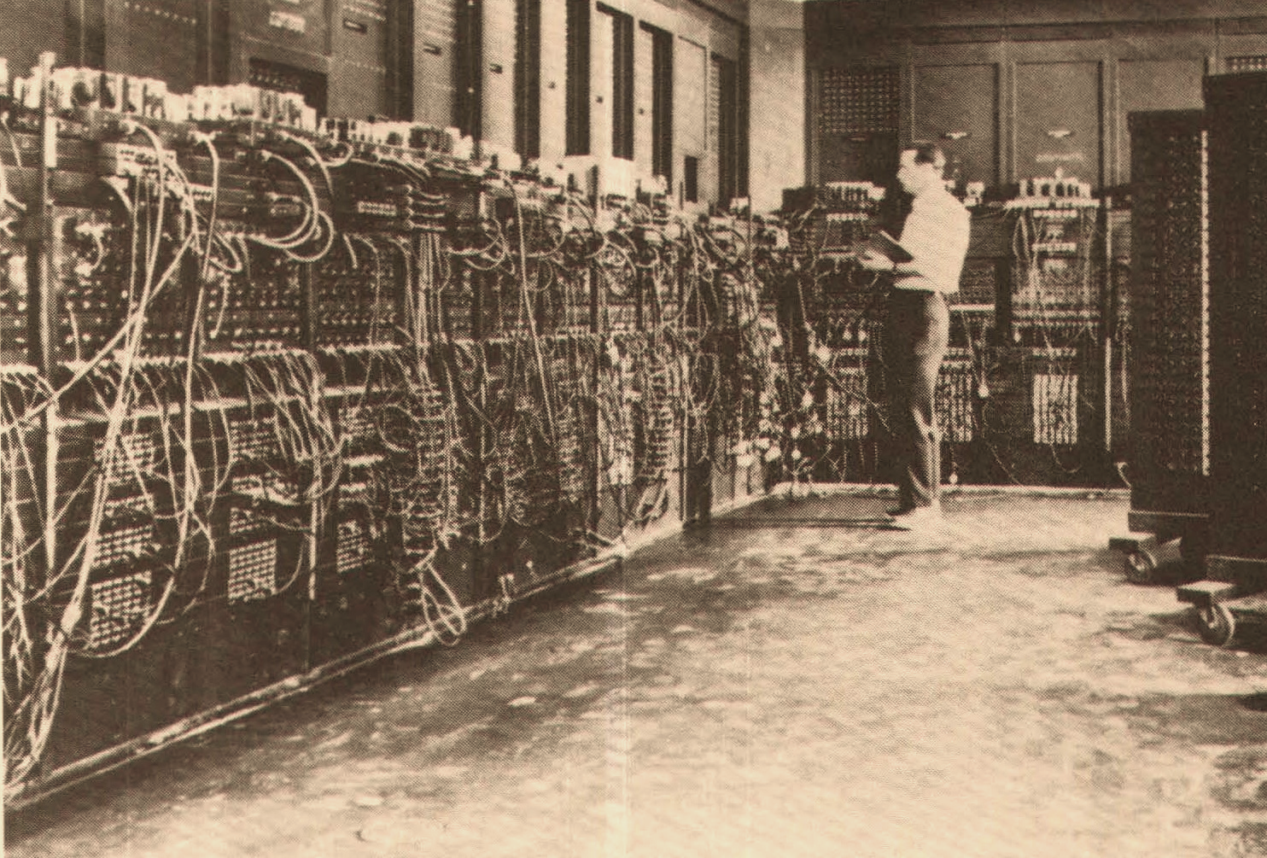
Advanced Examples

Slide 48
Multiple Data sets
library(dplyr)
mtCopy <- select(mtcars, -cyl)
# Use layers to control the colour of points
ggplot() +
geom_point(data = mtCopy, aes(x = wt, y = mpg),
color = "grey65") +
geom_point(data = mtcars, aes(x = wt, y = mpg)) +
# Note that cyl only exists in mtcars not carCopy
facet_grid( ~ cyl) +
ggtitle("MPG vs Weight Automobiles (1973–74 models)\nBy Number of Cylinders\n") +
xlab("Weight (lb/1000)") +
ylab("Miles per US Gallon")

Slide 49
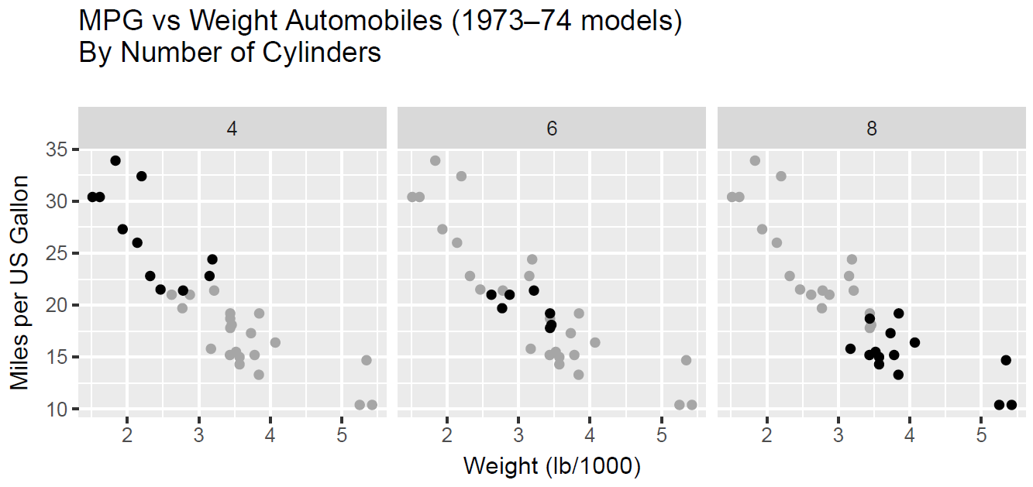
Multiple Data sets

Slide 50
Themes
The default ggplot2 theme is a grey background
It is easy to modify themes using theme_ layers
Themes can be set using the theme_set function
Themes can be queried using the theme_get function
For an individual plot, individual elements may be modified using a theme function layer
Theme elements can be controlled using element_ functions

Slide 51
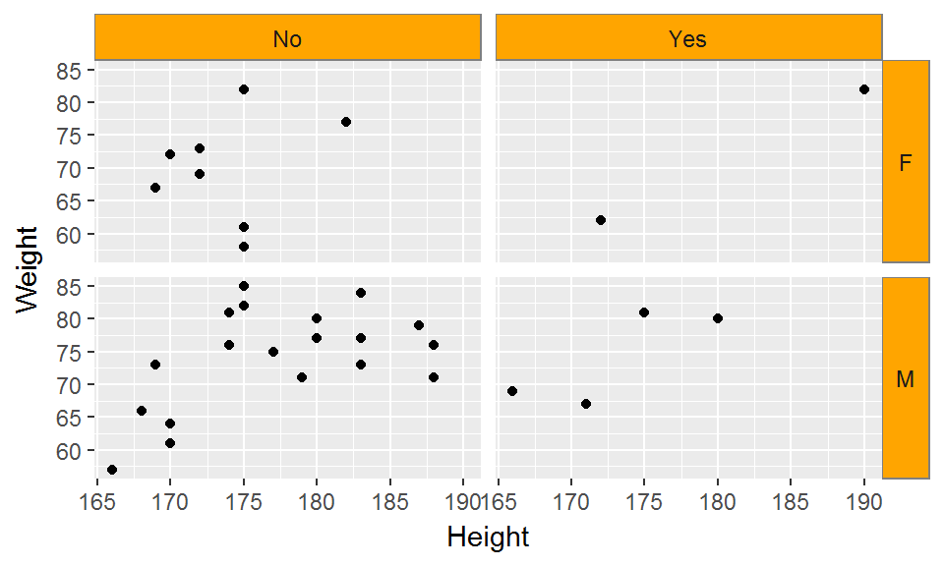
Themes
thm <- qplot(Height, Weight, data = demoData)
# Create a panelled plot:
thm <- thm + facet_grid(Sex ~ Smokes)
# Now rotate the text in the row strips
thm + theme(strip.text.y = element_text(angle = 0),
strip.background = element_rect(fill = "orange",
colour = "grey50"))

Slide 52


EARL London 2018
11-13 September
Abstract submissions close 31 March
Spaces for 30 and 10 mins talks
Visit: earlconf.com
Notes:
Abstract submissions are closing on 31 March – so make sure you send yours in before abstracts close! We’d love to hear from you if you want to share your R story. For 2018, we’re mixing things up and accepting abstracts for lightning talks as well as the usual 30 minute slots. These lightning talk slots are 10 minutes long, so please send your submissions now! Go to earlconf.com to submit your abstract.

Slide 53

10% discount for
LondonR members
Code: LondonR
Notes:
LondonR members get an exclusive 10% off EARL tickets – just enter ‘LondonR’

Slide 54
Agenda
Catie Gamble, M&S - Using R to Understand Revenue Opportunities for your Online Business
Andrie de Vries, RStudio - Tools for using TensorFlow with R
Jeremy Horne, MC&C Media - The power of machine learning in segmenting CRM databases
Chris Hughes, Mango Solutions - RStudio Conference round up
Notes:
After this afternoons workshop – we have these 4 presentations starting from 6pm

